Slide 1
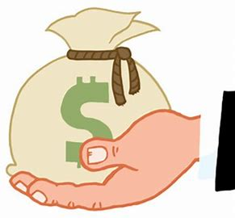
Attention Families of Graduating Seniors…
Lunch Balance Info
With the end of the year quickly approaching, we ask that you please review your student’s lunch account. If your account is negative, district policy states that your diploma will be held until the balance owed is paid in full.
If your student has a positive balance, funds will be transferred to a younger sibling in the district in the weeks following the end of the school year. For students with more than one sibling, these funds will go to the account of the oldest sibling unless there is another sibling with a negative balance. If there is a negative balance to be paid, funds will be transferred to that siblings account.
For all other accounts with a positive balance, families should request a refund by Friday, July 18th by contacting our offices at Jennifer.Oliver@neenah.k12.wi.us or Megan.Burggraf@neenah.k12.wi.us. You may also request to donate your positive balance to help other graduating students to pay their negative balances.

